Slide 1
FARMS Program
FACILITATING
AGRICULTURAL
RESOURCE
MANAGEMENT
SYSTEMS
Notes:
FARMS is a collaborative effort of the District and FDACS

Slide 2
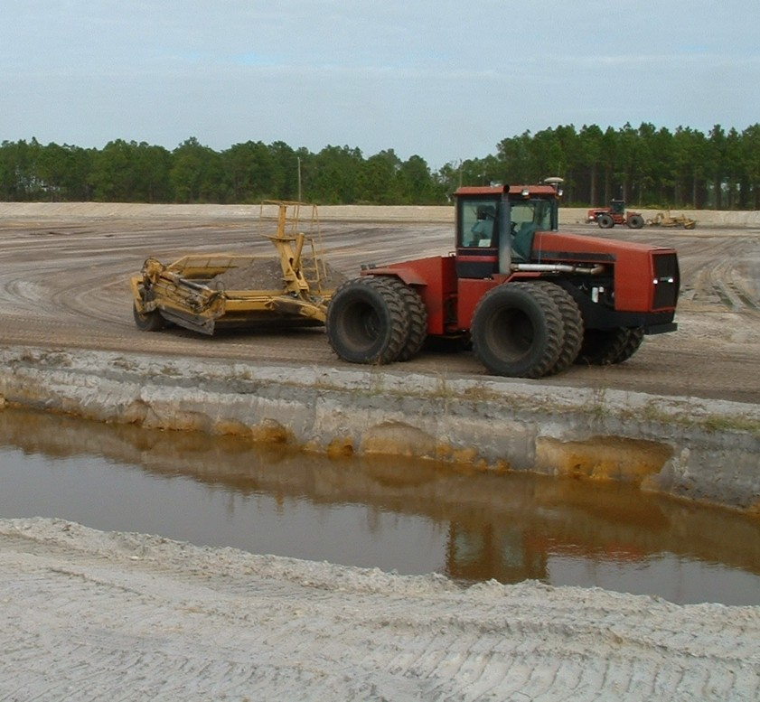
FARMS Program - Defined -
FARMS is a Best Management Practice (BMP) Cost-Share Reimbursement Program for Agricultural Operations Located within the SWFWMD

Slide 3
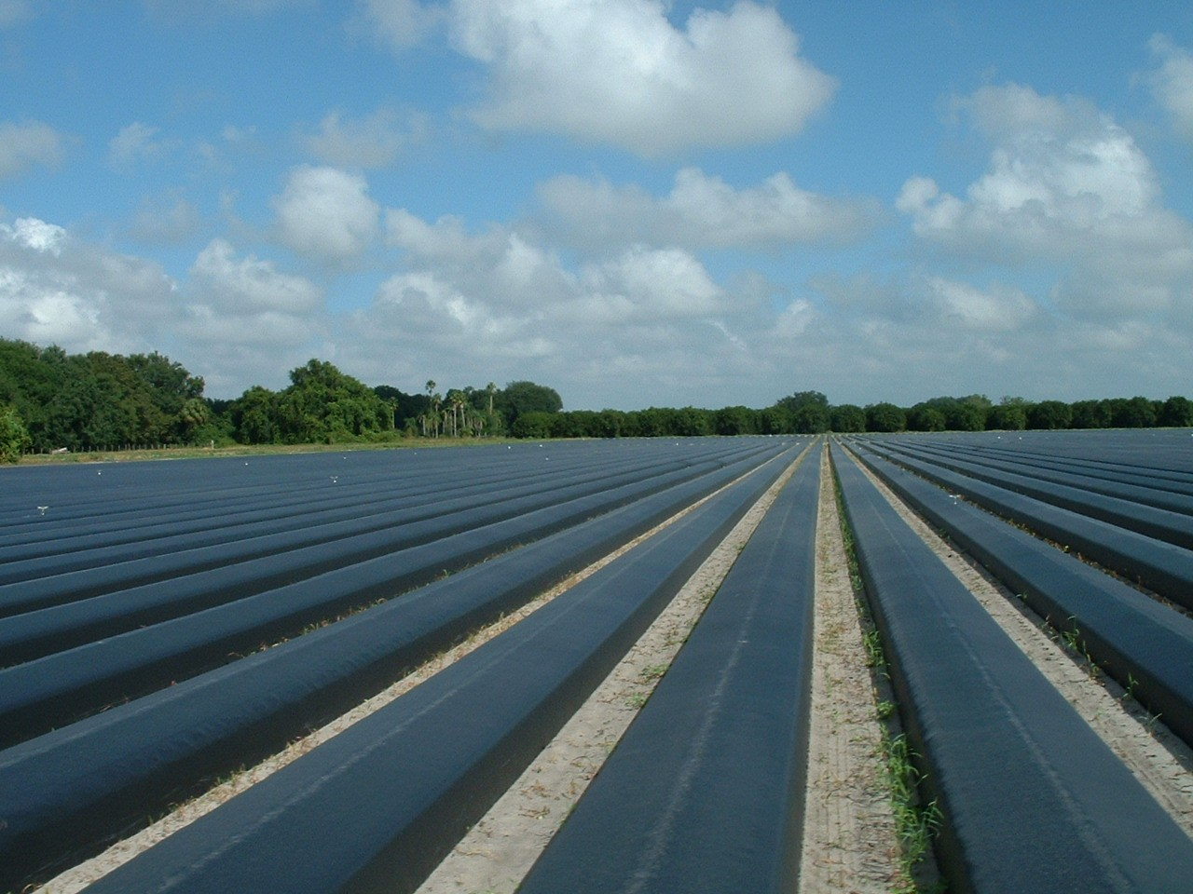
FARMS Program - Initiatives -
Promote Public-Private Partnerships to Implement Agricultural BMPs to:
Reduce Floridan Aquifer Withdrawals
Improve Water Quality
Conserve, Restore, or Augment Water Resources and Ecology
Notes:
Water conservation objective is part of the SWUCA Recovery Strategy
Water quality refers to naturally occurring mineral ions in GW
Enhance natural system functions

Slide 4
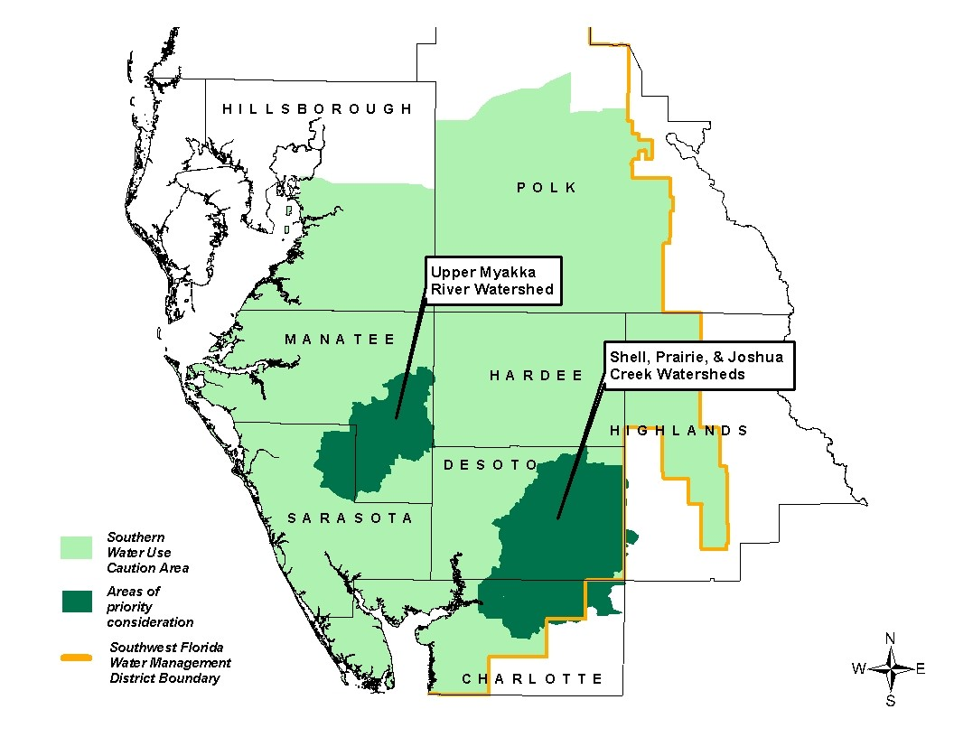
SWUCA MAP
Notes:
FARMS was expanded include the entire SWUCA, with SPJC and UMRW being designated as priority areas.
Reimbursement rate depends on BMPs addressed:
Quantity or Quality or UMRW = 50%
Quantity + (Quality or UMRW) = 75%
Quantity (UFA >50%) = 75%

Slide 5
FARMS Program Overview
Requires application, staff and Governing Board approval, and 5 year to 20 year contract
Proposed projects must be in compliance with existing permits
Properties must be existing agricultural operations for three years prior to application
Can fund irrigation retrofits; need NRCS co-apply
Does not fund earth-moving, labor, or consultant services; can be used as applicant’s match
Projects must meet a cost/benefit analysis
Implemented as rule 40D-26, F.A.C., Jan 2009

Slide 6
Interaction With Other Ag Programs
NRCS Environmental Quality Incentives Program (EQIP) - Several FARMS /EQIP Projects
SWFWMD Ag-Teams (each Service Office)
IFAS – BMP programs
FDACS Mini-FARMS
Soil and Water Conservation Districts
Approach extends financial and professional resources, ensures smooth project management

Slide 7
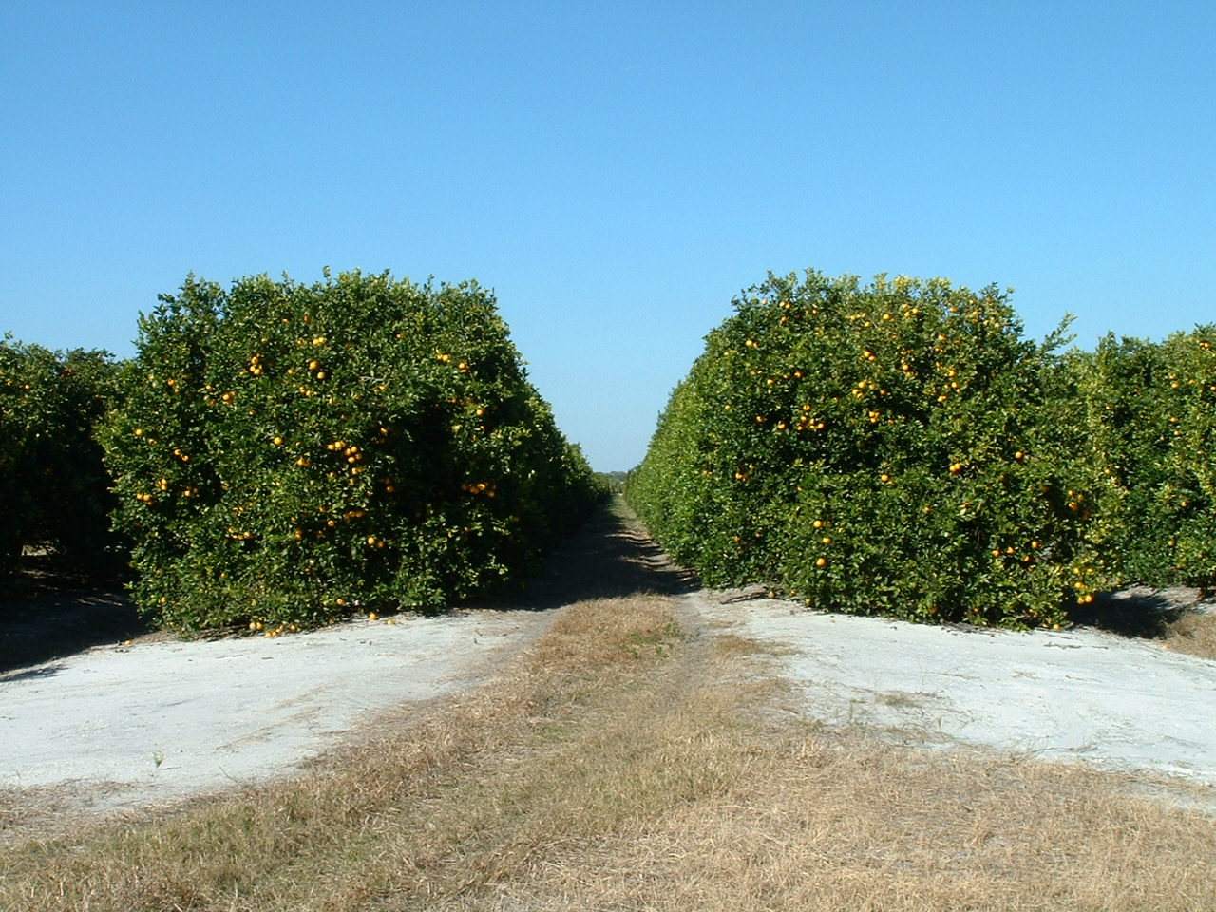
Program Highlights As of April 2010
87 Board Approved Projects
- 14.27 MGD Predicted Groundwater Offset
56 Operational Projects
- 11.1 MGD Predicted Groundwater Offset
- 7.5 MGD 12-Mo MAV Groundwater Offset
12 Additional Active Potential Projects
Notes:
Difference in Predicted offset versus Actual offset is due to the current drought and project implementation schedules.

Slide 8
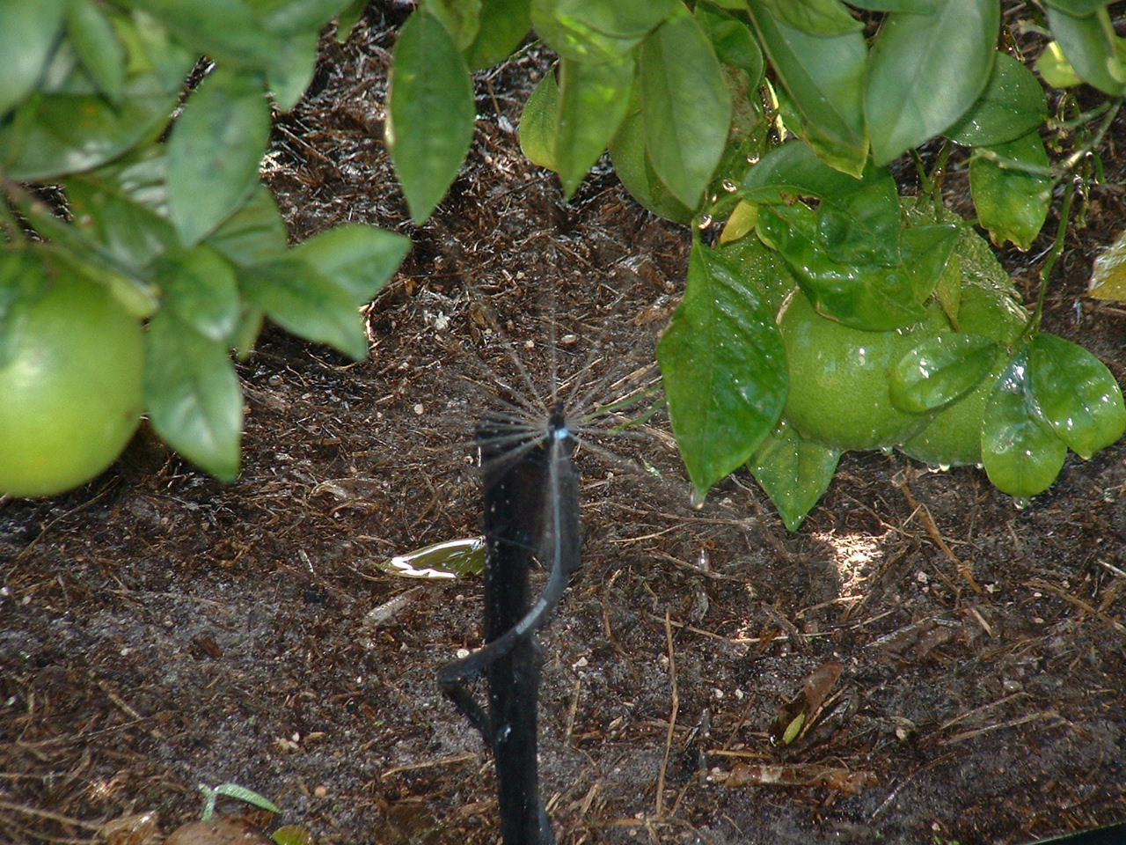
Funding thru FY2009
State Appropriations $ 5.3M
FDACS Contributions $ 1.2M
Governing Board Contributions $ 2.1M
Basin Board Contributions $ 1.9M
Grower $ 7.8M
Total Project Reimbursements $18.3M
42.5% Grower - 57.5% Public
Notes:
Economic conditions (State budget) have had an impact on the program. FDACS funding ceased in 2007; State appropriations ceased in 2009.

Slide 9
- Project Examples -
Alternative Irrigation Source
Tailwater Management and Recovery
Surface Water /Surficial Aquifer
Pumps, Filtration
Pipe to connect to the existing irrigation system
Water control structures
Chlorination/water treatment
Irrigation Management
Precision Irrigation Systems
Automated pump control
Automated valve control
Weather stations
Soil moisture sensors
Notes:
Tools to give farmer information needed to make decision about when to irrigate.
Grower saves fuel and labor costs, District saves water resources.

Slide 10
Examples of Surface Water Projects
Notes:
We cost-share all of the equipment you see in the photo: pumps, power unit, filtration, piping, shed. We only fund the mainline pipng to carry water from the reservoir to the grower’s irrigation system.

Slide 11
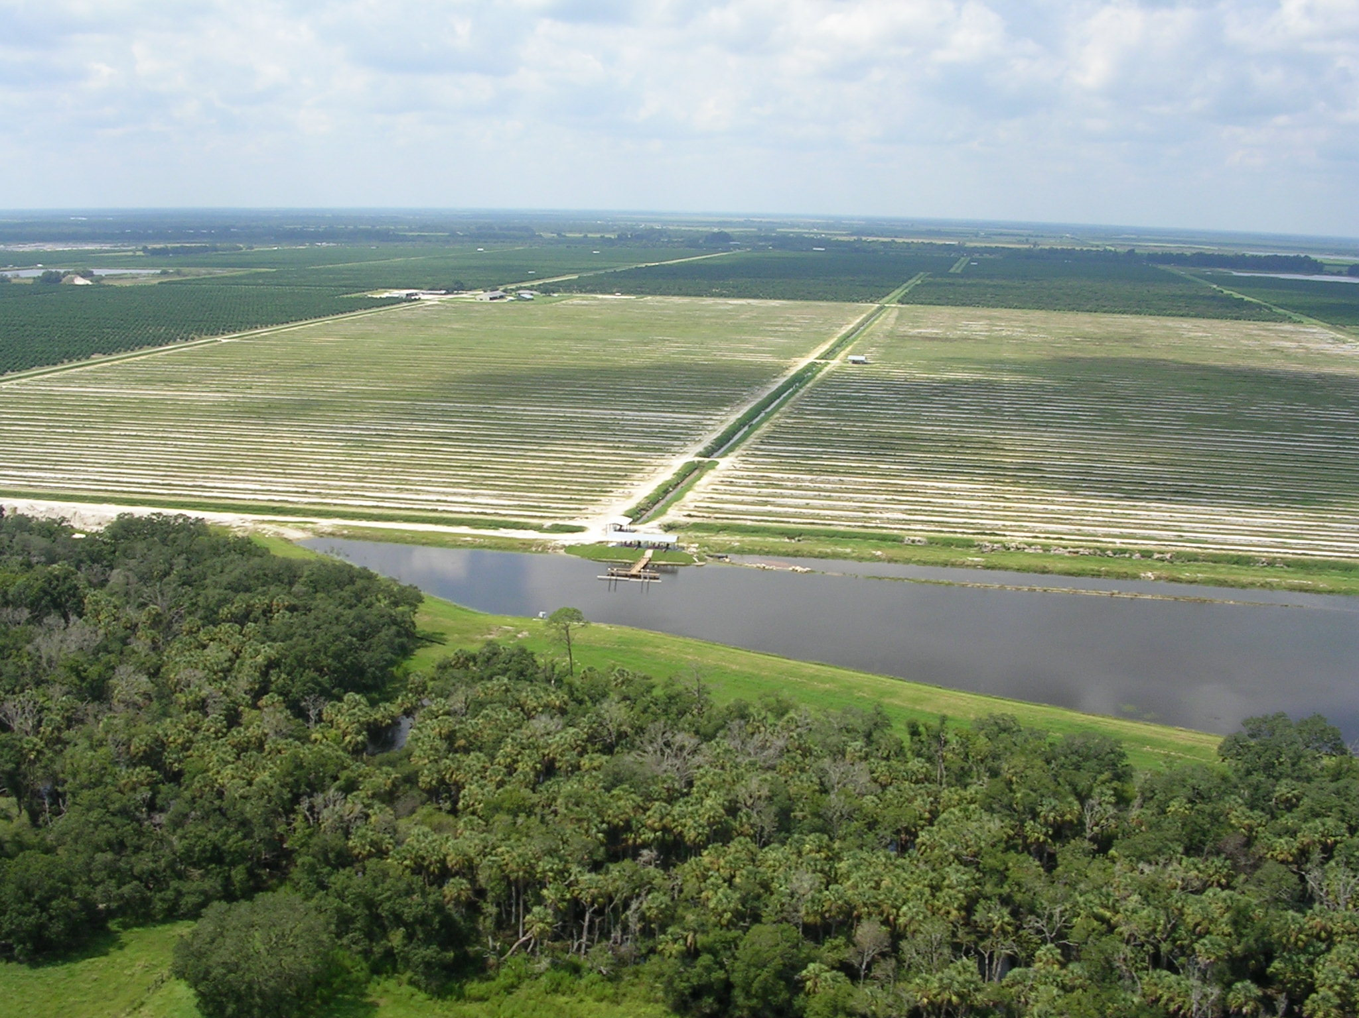
Notes:
This is 15-ac tailwater recovery pond serving 700 ac of a 1,200-ac orange grove in DeSoto Co; the first of three phases that will ultimately provide surface water to entire grove from 3 reservoirs.

Slide 12
Tailwater Recovery – Upper Myakka River
Notes:
Surface water management on McClure farm; note perimeter berms. Pumps move water within interior ditches to control water table for seepage irrigation.

Slide 13
Tailwater Recovery Ponds
Notes:
Two ponds on the Falkner Classie Farm: pond on the left captures field run-off and pumps irrigation water to other parts of the farm; pond on the right is used to store water from Coker Creek – gravity inlet when creek level is high.

Slide 14
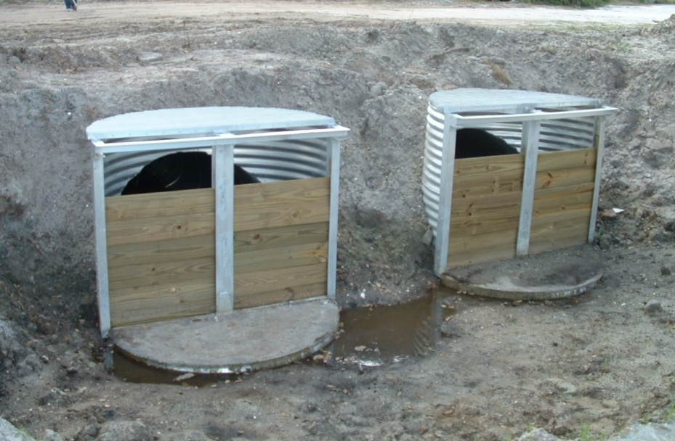
Surface Water Control
Culverts with riser boards
Better on-site water control for improved soil moisture conditions and irrigation savings

Slide 15
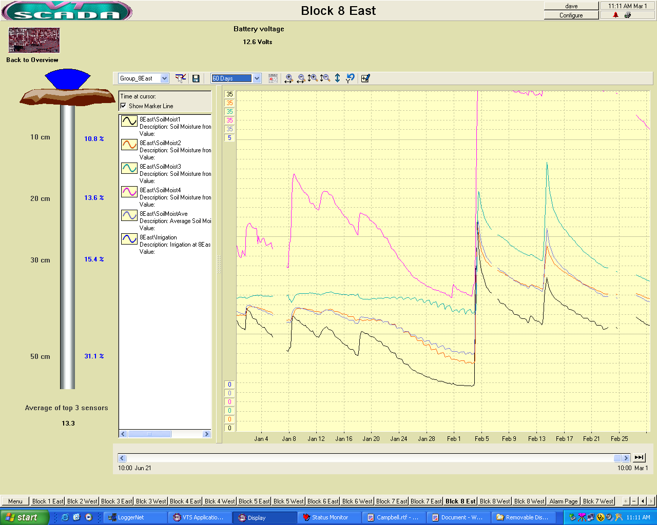
Precision Irrigation
Soil Moisture Meters
Auto Pump Starts/Valves
Weather Stations
Notes:
Upper left: weather station installed in an orange grove.
Lower right: real-time online graph of soil moisture levels at various probe depths

Slide 16
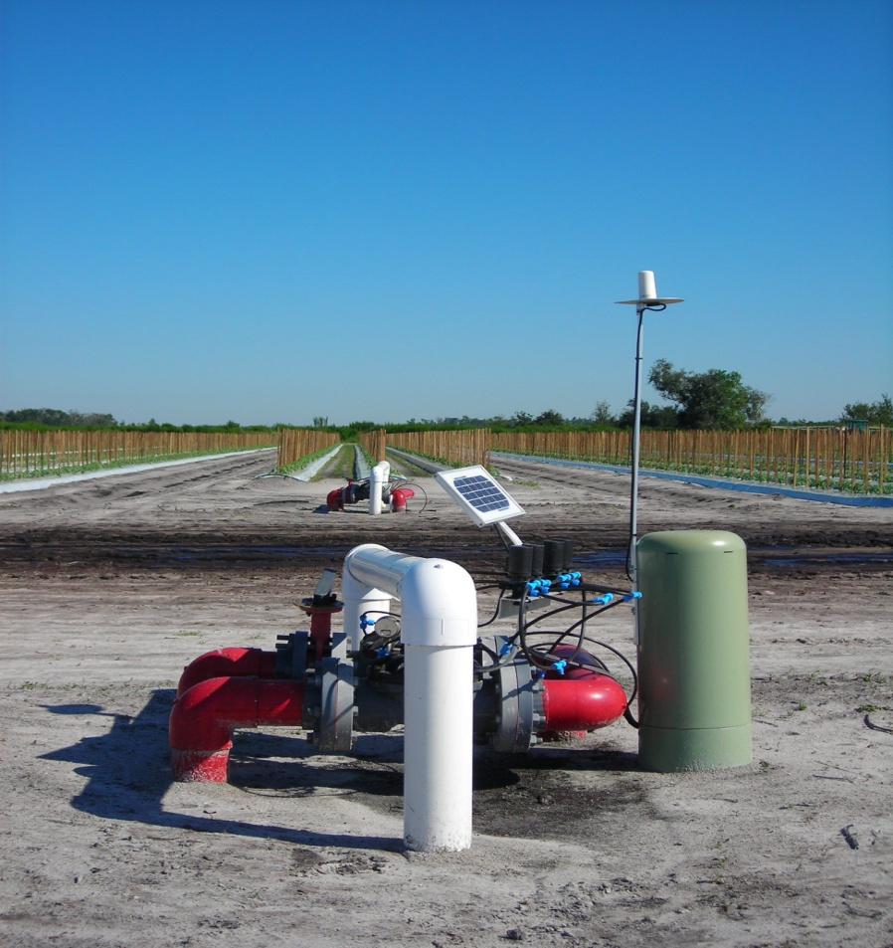
Precision Irrigation
Notes:
Left: tomato farm – soil moisture probe inside green cover with telemetry to control unit; solar powered remotely controlled zone valve

Slide 17
Flatford Swamp Summary
Size: 4.5 square miles (2,880 acres)
Tree mortality noticed in mid-1990’s
December 2008 – Myakka River Watershed Initiative - Water Budget Model Development and Calibration
April 2009 – Myakka River Watershed Initiative - Evaluation of Flatford Swamp Flow Diversion Scenarios
Tree mortality due to hydrologic stress from high water elevations and longer hydroperiods
District involvement with remediation since 2000
Notes:
Several tree mortality studies made in late 1990
The water budget model uses continuous simulation

Slide 20
Falkner – Classie Farm
Surface Water Exchange project
Capture surface water before
entering Flatford Swamp
Capture and recirculate tailwater
Irrigates 1,185 ac of 9,230 ac farm
Notes:
2.28MGD actual / 2.17 MGD projected
$1.5M FARMS / $3.1M Total Project

Slide 21
.
PTG – Myakka Farm
Surface Water Exchange project
Reduce dry season levels in the
Swamp
Recover and reuse tailwater
Irrigate 950 ac of 3,225 ac farm
Notes:
380 gpd actual / 920 gpd projected (850 / 920 in April 2009)
$373,000 FARMS / $746,000 Total Project

Slide 22
Cameron Dakin Dairy
Reduce GW usage on 120 ac.
Improve downstream water quality in UMRW by
reducing nutrient loading
Recover and reuse tailwater
Reservoir to capture and reuse dairy waste
water
.
Notes:
99 gpd actual / 79 gpd projected
$85,000 FARMS / $226,000 Total Project

Slide 23
.
ESDA Dairy
Capture and reuse tailwater to improve water quality and reduce potential
downstream nutrient loading
Reduce overall GW pumping on 328 ac. dairy
Precise management of barn flushing, cattle washing and field irrigation
Project just recently completed so no meaningful data history
Notes:
45,000 gpd projected
$144,000 FARMS / $158,000 Total Project

Slide 24
McClure Farms
Reduce GW usage
Improve on-site water quality
Capture and reuse tailwater to reduce
impacts to Swamp and UMRW
Irrigate 1,200 ac. row crop farm
.

Slide 25
.
4-Star Long Creek
Reduce GW pumping
Improve natural system functions in UMRW
Capture and reuse tailwater and storm runoff
Intercept seepage adjacent to Long Creek; network of data loggers to
document performance of the project
Irrigate 800 ac of 1,240 ac row crop farm
Recently approved, contract is pending
Notes:
100,000 gpd projected
$102,000 FARMS / $158,000 Total Project

Slide 26
FARMS Program
Sustaining Agriculture and Water Resources
Thank You
www.watermatters.org\agriculture\FARMS

